Slide 1
Guest Lecture Stanford ME469: Nalu Overview
Stefan P. Domino
Computational Thermal and Fluid Mechanics
Sandia National Laboratories SAND2018-4619 PE

Slide 2
Nalu Overview: Outline
Nalu Technology Origination: ASC
Beyond the 32-bit Limit
Supported Physics
Supported Numerics
Low- and High-order
Moving Mesh (Sliding and Overset)
Multiphysics:
Fluid Structure Interaction
Conjugate Heat Transfer (CHT)
Participating Media Radiation
Conclusion

Slide 3

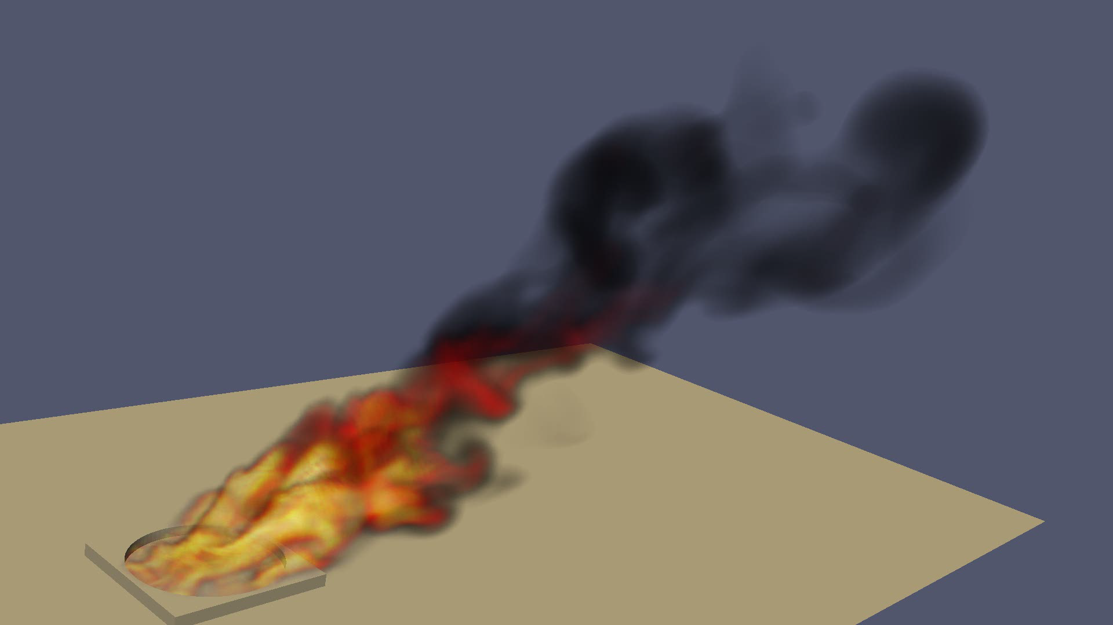
Core Technology Provided to Nalu Origination: Advanced Simulation and Computing Sierra/Fuego
Use-case characterized by a highly sooting, turbulent, reacting flow with Participating Media Radiation (PMR), Conjugate Heat Transfer (CHT), and propellant mutiphysics coupling
Complex geometry has driven a generalized, hybrid unstructured discretization approach supporting Hex8, Tet4, Wedge6, and Pyramid5 elements in addition to arbitrary promotion of Hex8 to Hex27, Hex64, etc.

Slide 4
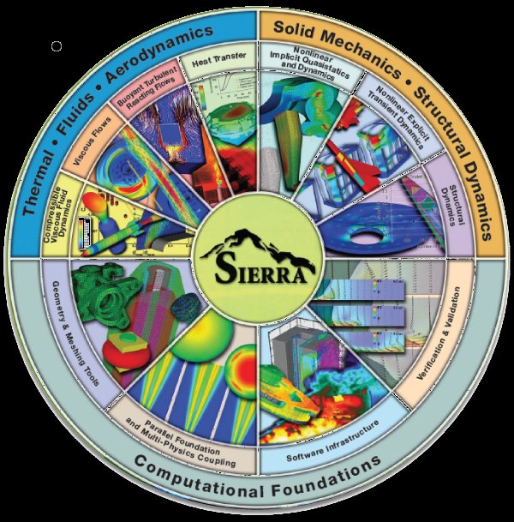


Goal: Beyond 32-bit Computing
Circa 2013, many scientific production codes were limited to 32-bit
Therefore, maximum simulation size for entities, e.g., node, edge, face, element, etc., was ~2.2 billion
Next Generation Platforms were advocated to overcome poor MPI scaling and power needs to support Exascale computing (10¹⁸ floating point operations/second)
Platform architectures are not yet known
+ ASC IC
Investments
( )
Sierra Toolkit/Trilinos (open-source)
MPI+X parallelism
Support for new architectures

Slide 5
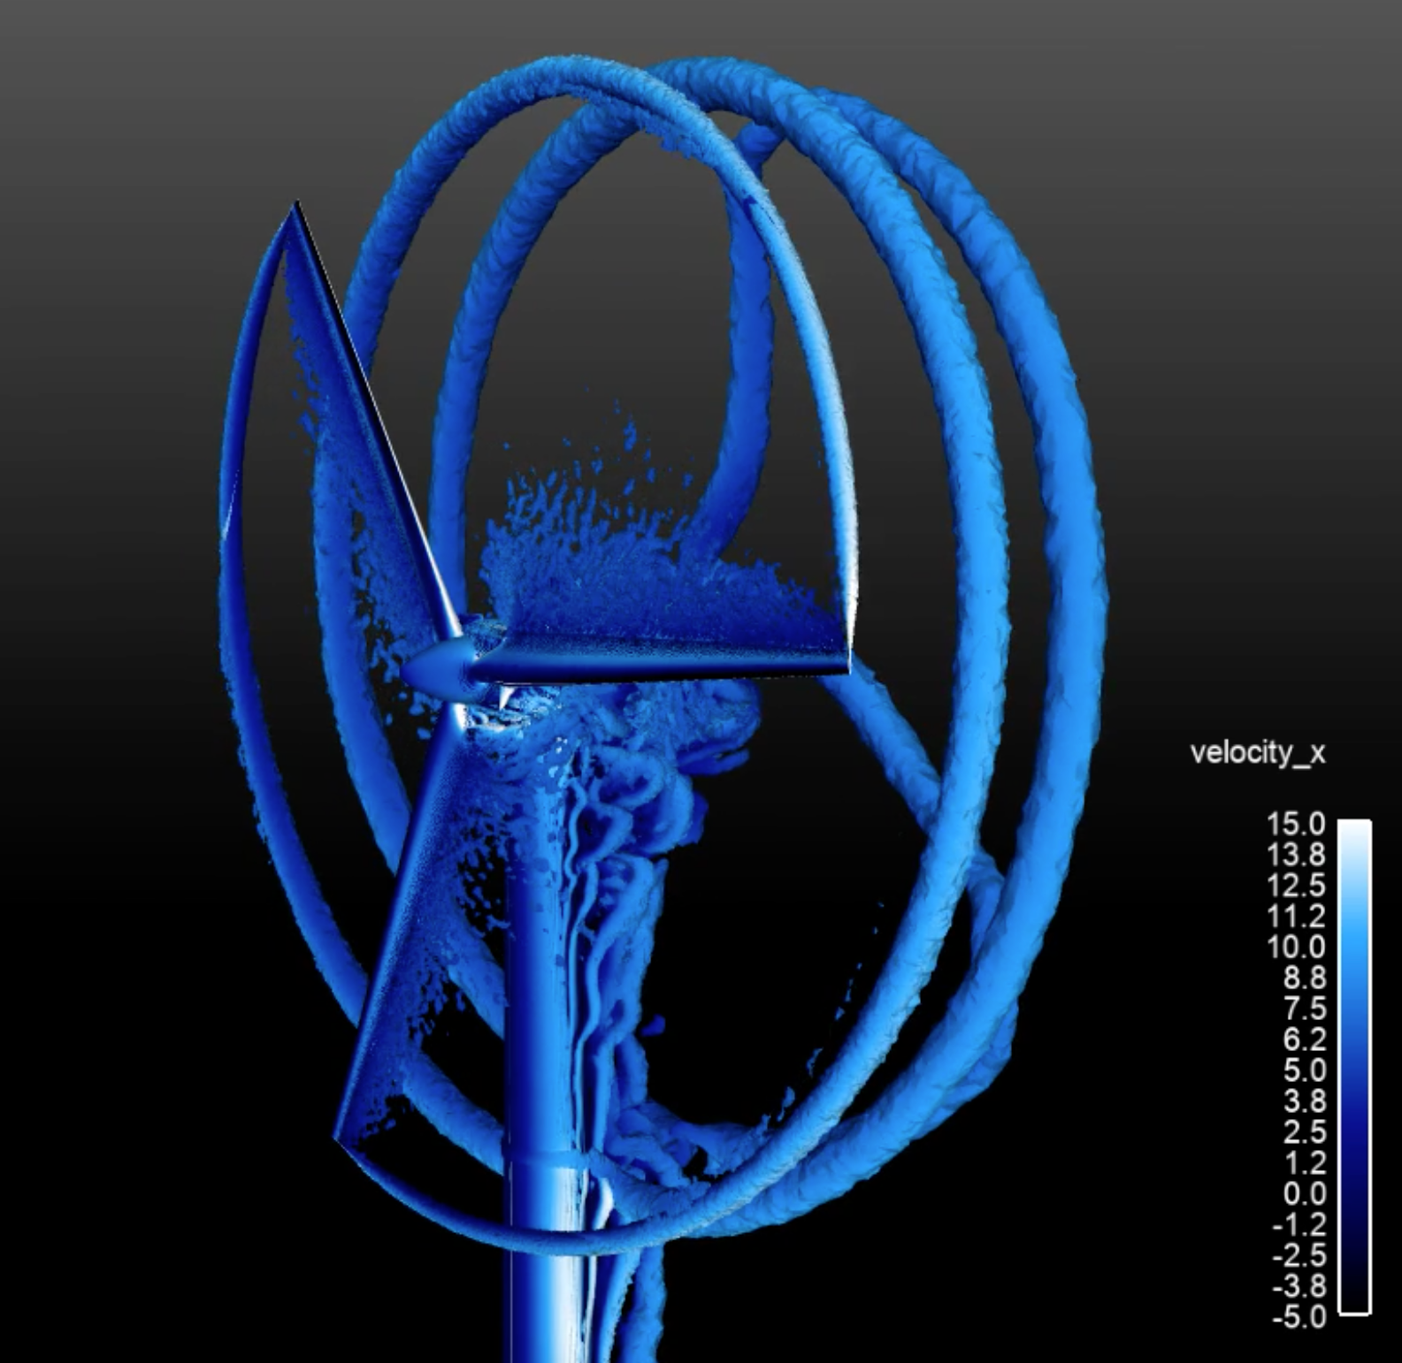
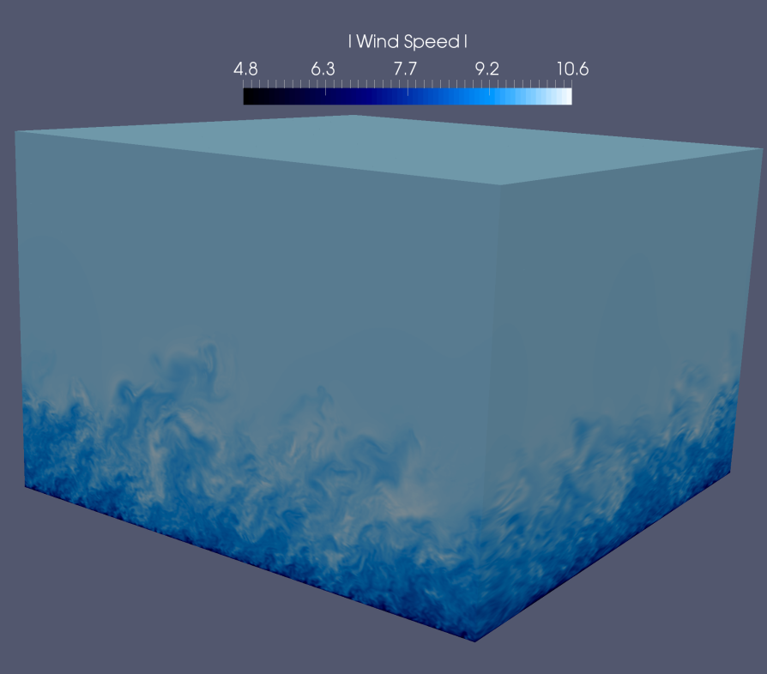
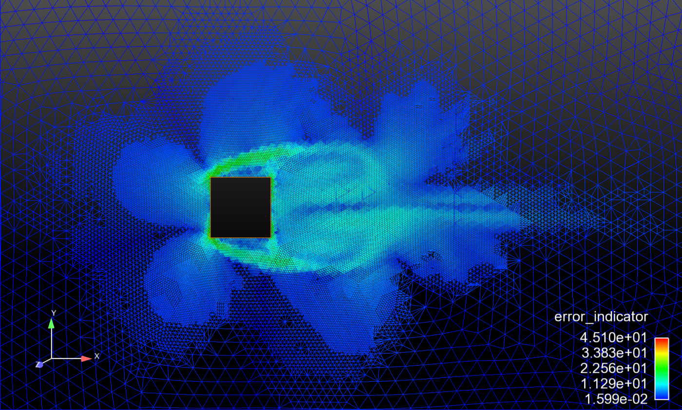
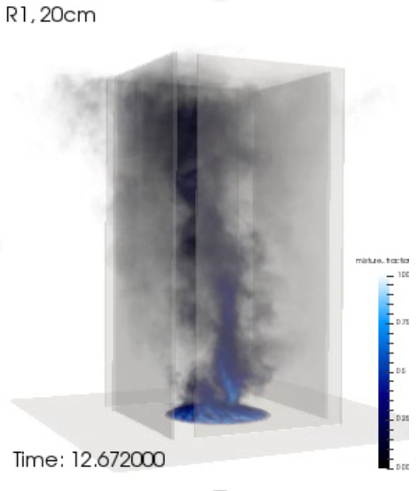
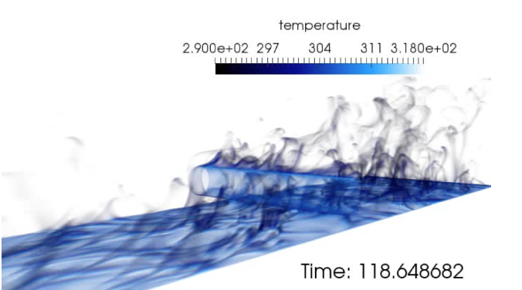
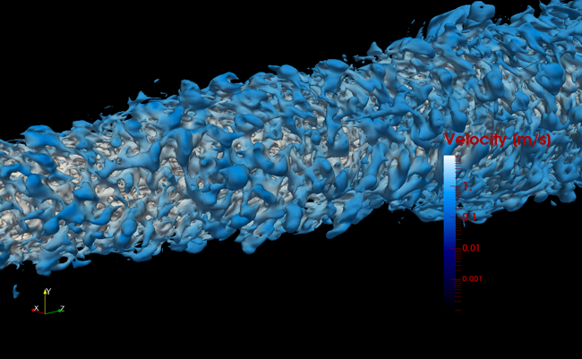
Supported Physics

Slide 6
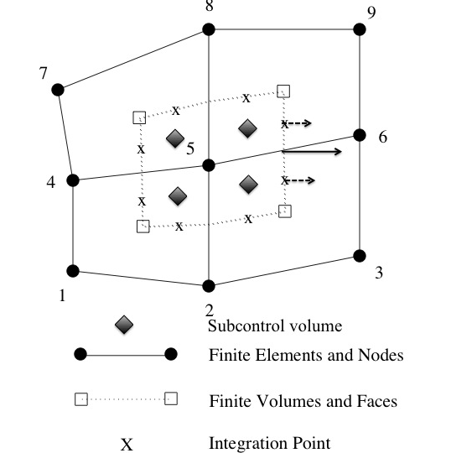
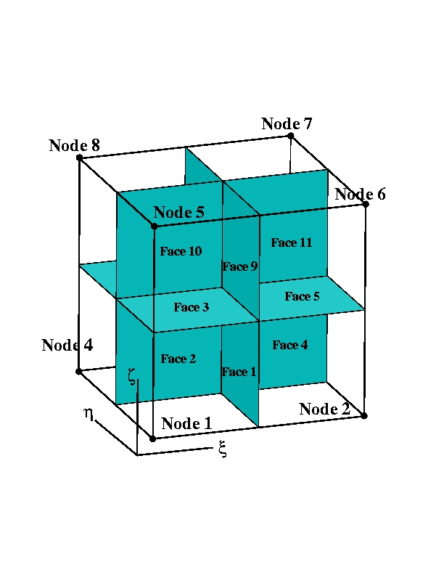
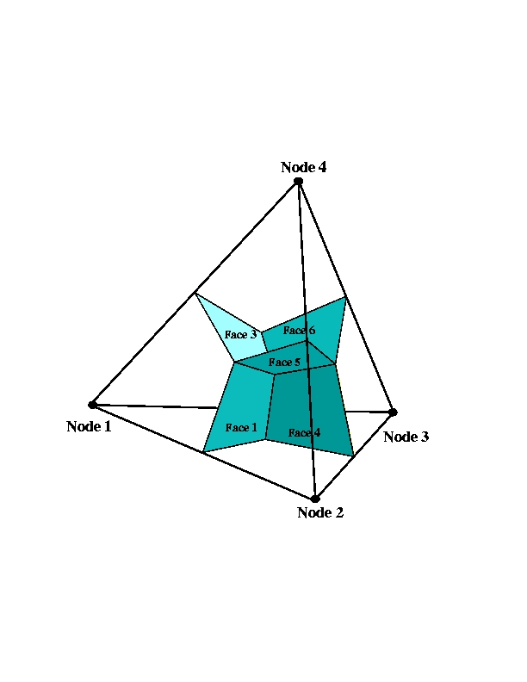
Supported Discretizations: CVFEM/FEM/EBVC
The core discretization used in the low Mach code base has been the Control Volume Finite Element Method, CVFEM
Finite Element Method and Edge-based Vertex-Centered, EBVC, are also supported

Slide 7
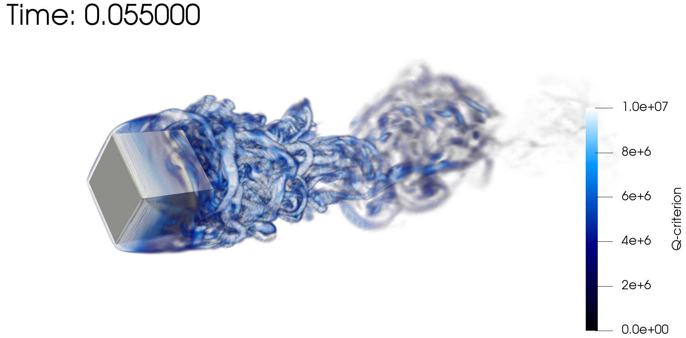

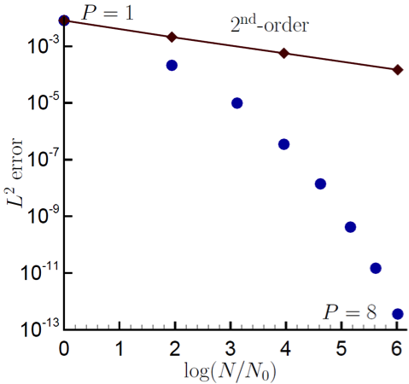
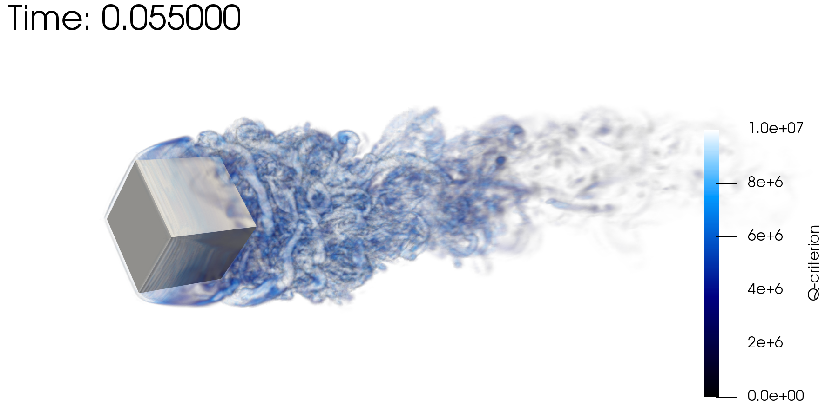
Scientific Research Platform to Evaluate Higher-Order Methods on Next Generation Platforms
As the cost of parallel assembly increases, should we strive to perform more local work? Higher-order achieves this design-point (at the cost of a larger memory footprint)
Spectral convergence
Dual-volume
for promoted quad4
Flow-past rotating cube
Re~4000, RPM~3200
Same node count,
P=1 (top) P=2 (bot)

Slide 8

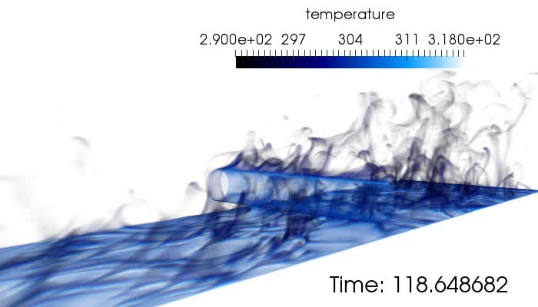
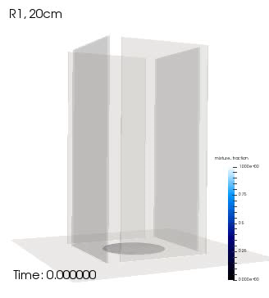
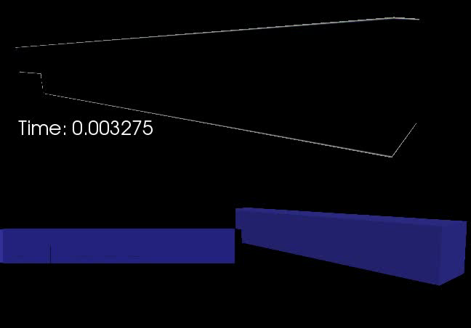
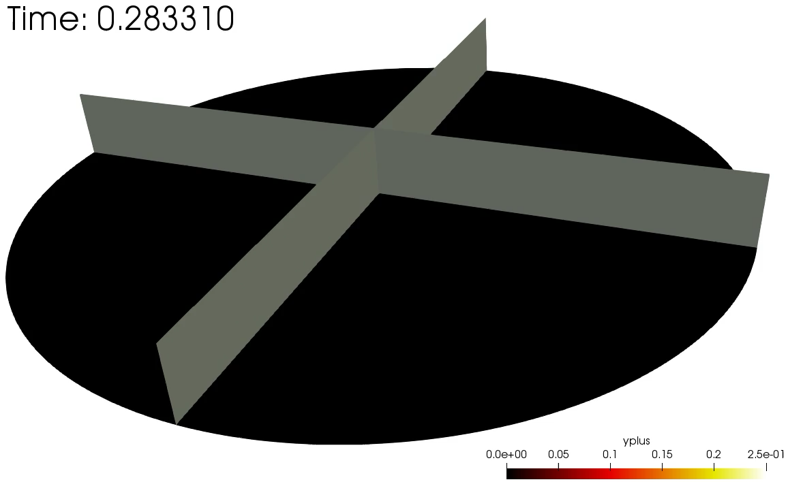
Several Multi-physics Flow Examples
Cylinder in cross flow
Helium plume (low-/high-order)
Heated backstep
Whirling behavior
Impinging Jet DNS

Slide 9
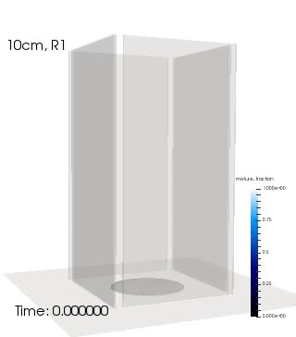
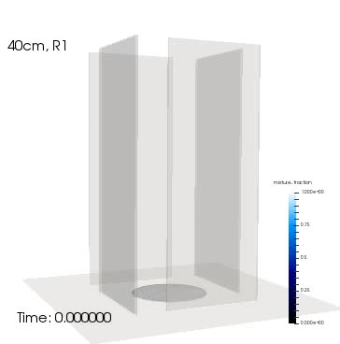
Evolution of a Mindset….. Modeling Whirling-like Flow
SAND2019-7052 C
Idealized chamber in which swirl is provided by selective wall placement in the experimental design
Gap varied between 10, 20, and 40 cm
Objective: Can the onset of swirl be predicted? What is the strength?
Volume rendered mixture fraction
Notes:
Fire whirls are complex phenomena that we are just understanding and, only recently, can model.
This is an example where we have engineered slots in walls that inspire vortical flow in the inner chamber. The plume accelerates upward and, therefore, entrains fluid. The slots provide a large-scale clockwise rotation.

Slide 10
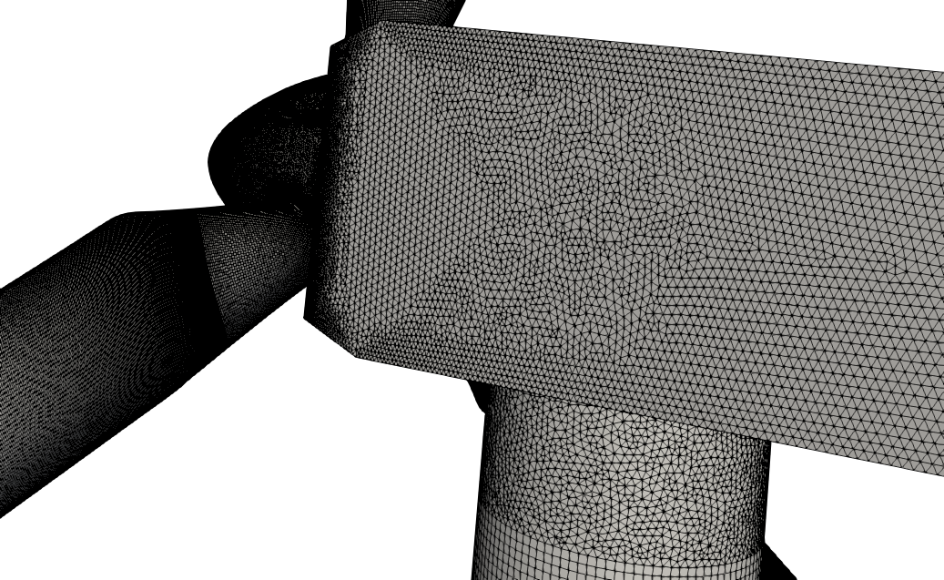
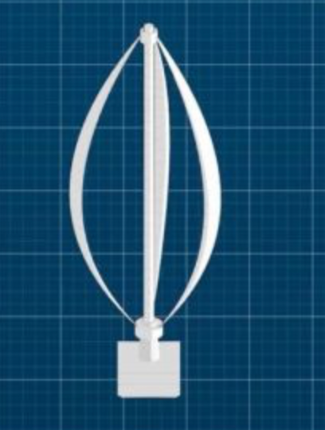
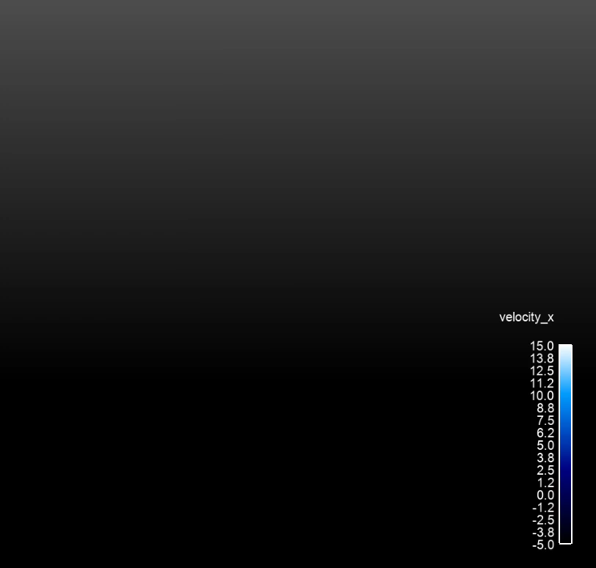
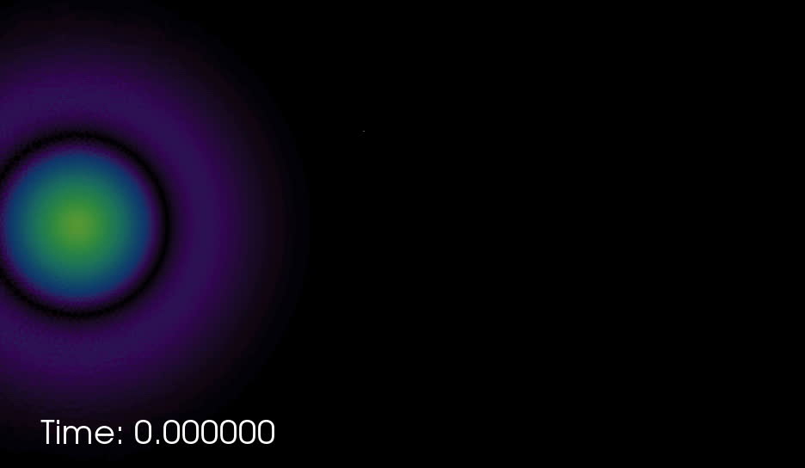
Unique Wind Energy Needs
Low-dissipation methods with suitable nonlinear stabilization operators to perform blade-resolved physics
Complex rotating blades, pitching blades, with possible yaw
Transition from low-order (near the blade) to higher-order (in the wake)
Generalized, unstructured, hybrid low-order simulations shown
Horizontal Axis Wind Turbine
(HAWT)
Vertical Axis Wind Turbine
(VAWT)

Slide 11
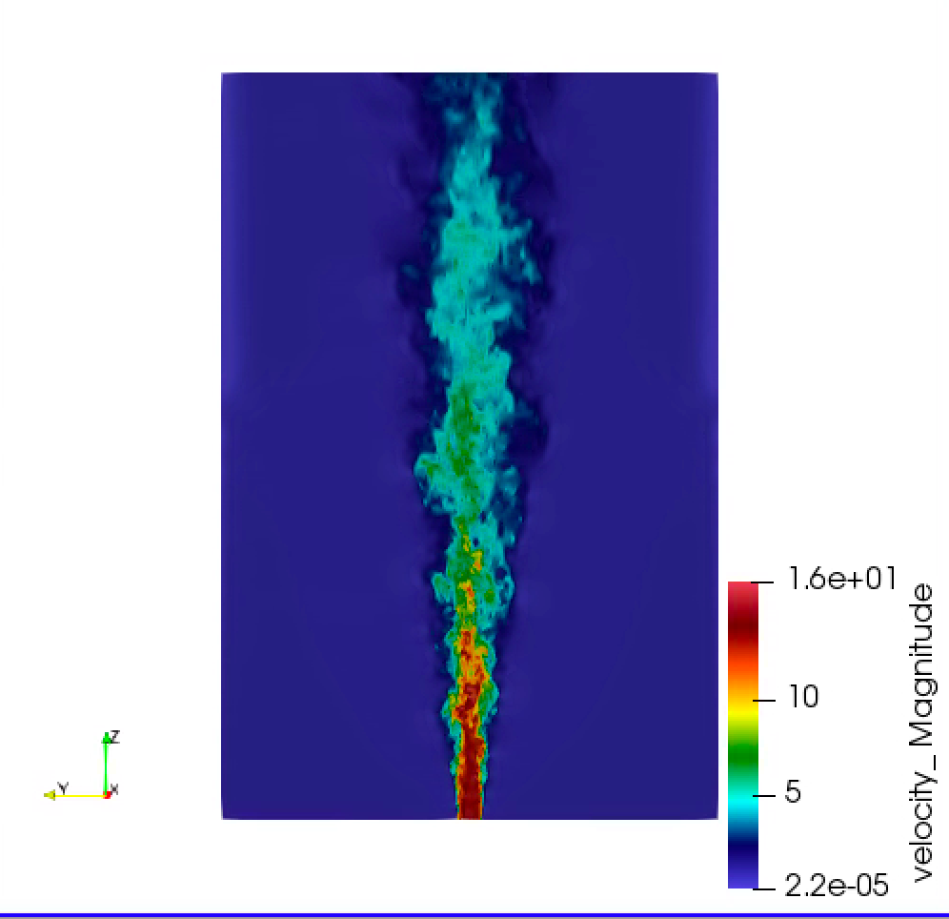


Developed Open-Source BSD-clause 3 Distribution Policy
Philosophy: Open-source collaborations
https://github.com/NaluCFD
(soon)

Slide 12
Nalu History
A time-history of the Nalu code base:
By CFD standards, this is a relatively new code base
Sierra/Nalu
SNL License
UIUC (Pantano and Knaus)
Open-source
BSD License (2014)
Github
NaluCFD
Active
academic partners
ECP ExaWind (2018)
Github
Nalu-Wind
Open-source: NREL, SNL, ORNL, UT joint copyright

Slide 13
Nalu Overview: Conclusion
Nalu’s technology has its roots in the ASC Sierra/Fuego effort
Multi-physics capabilities are in development
Research platform for high-order low-Mach methods
Open-source collaboration model
Funded through ASC, ECP, A2e, ASCR, and LDRD

